Slide 1
🌱 EcoSpendAI
AI-Powered Sustainable Expense Tracker
SDG 12 • Responsible Consumption
Presented by
Vaishnavasreyas M
B.Tech Computer Science & Engineering
Carmel College of Engineering & Technology
IBM SkillsBuild Internship Project

Slide 2
Problem Statement
Students manage their daily expenses, but they rarely understand the environmental impact of their purchases.
Objectives
Track daily expenses digitally.
Estimate CO₂ emissions for each expense.
Provide AI-powered eco-friendly tips.
Encourage sustainable spending habits (SDG 12).

Slide 3
Proposed Solution
🌱 AI-powered expense tracker
💰 Record daily expenses by category
🌍 Calculate estimated CO₂ emissions
🤖 Suggest eco-friendly tips instantly
📊 Visualize spending with charts
Outcome: Smart,eco-friendly spending decisions

Slide 4
System Architecture

Slide 5
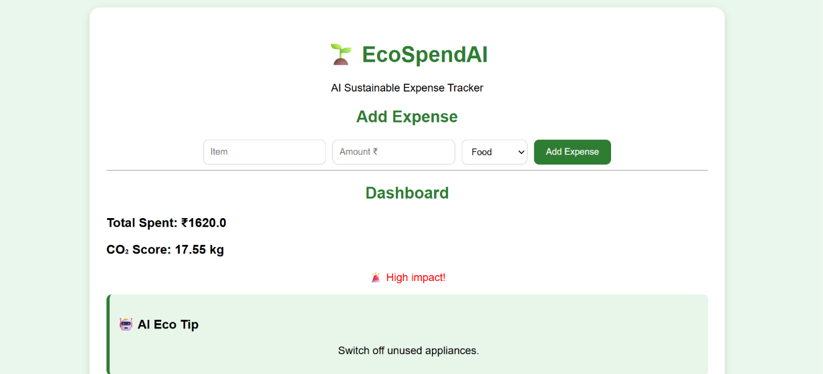
Working
User enters item, amount and category.
Shows total spending and CO₂ score.
Gives an instant eco-friendly suggestion.

Slide 6
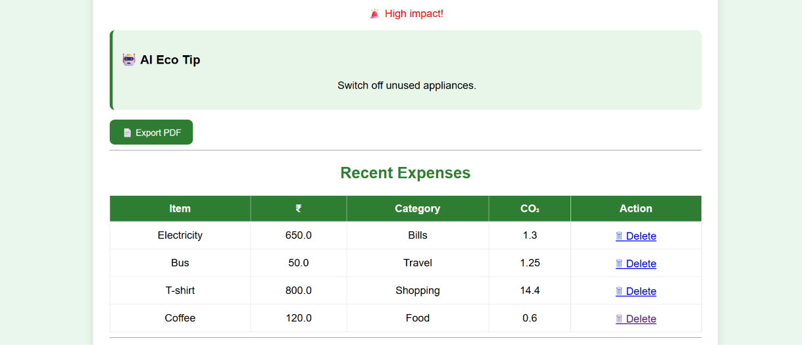
Results: AI Dashboard

Slide 7
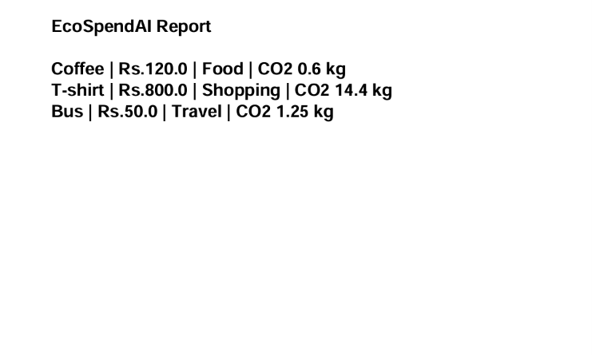
Results: Report

Slide 8
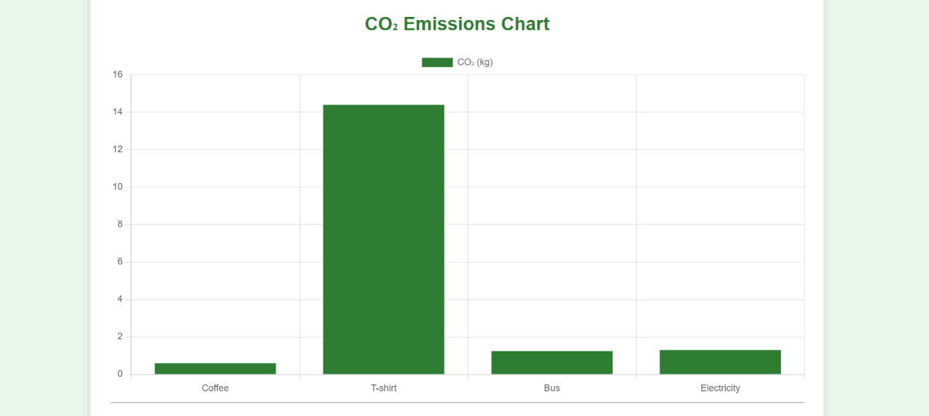
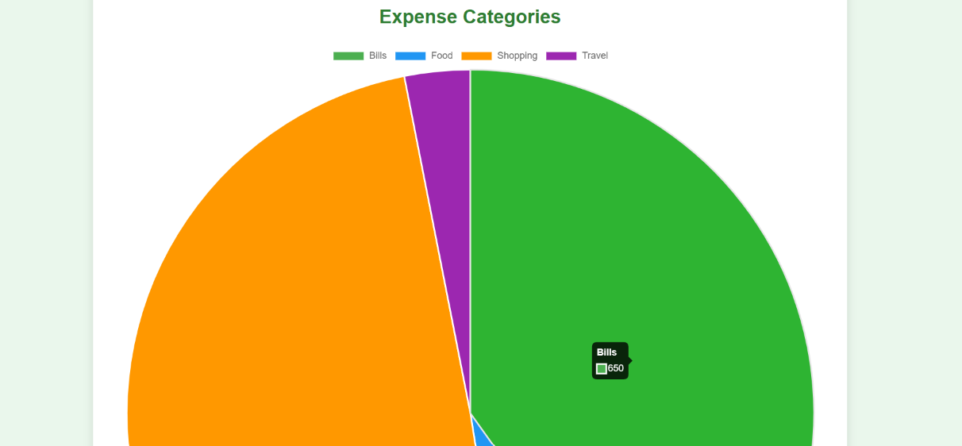
Results: Charts and Analysis
Expense Distribution
Displays the percentage of spending across different categories.
CO₂ Emissions Chart
Shows which expense category creates the highest carbon footprint.

Slide 9
Conclusion & Future Scope
Conclusion
Digital expense tracking with AI
CO₂ footprint awareness
Supports SDG 12 sustainable consumption
Future Scope
Real AI chatbot (IBM Granite)
Monthly budget prediction
Receipt scanning with OCR
Mobile app version
Thank you!

